Slide 1
Parsons Problems
Mark Clarkson
CAS North East Conference 2019

Slide 2
Starter
Write down the lyrics for the
first verse of Elton John’s
Your Song

Slide 3
Or rearrange these lines
And this one's for you
I don't have much money but boy if I did
If I was a sculptor but then again no
It's a little bit funny this feeling inside
I'd buy a big house where we both could live
I'm not one of those who can easily hide
Oh I know it's not much but it's the best I can do
Or a man who makes potions in a traveling show
My gift is my song

Slide 4
Or rearrange these lines
It's a little bit funny this feeling inside
I'm not one of those who can easily hide
I don't have much money but boy if I did
I'd buy a big house where we both could live
If I was a sculptor but then again no
Or a man who makes potions in a traveling show
Oh I know it's not much but it's the best I can do
My gift is my song
And this one's for you

Slide 5
How do I start?

Slide 6
Programming equivalent
Write a computer program to simulate a Magic 8 Ball
……………………………………………………………………………………………………
……………………………………………………………………………………………………
……………………………………………………………………………………………………
……………………………………………………………………………………………………
……………………………………………………………………………………………………
……………………………………………………………………………………………………
……………………………………………………………………………………………………

Slide 7
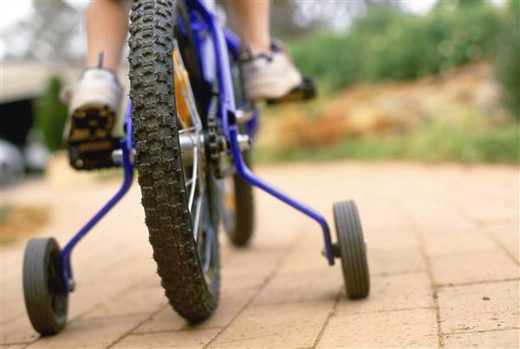
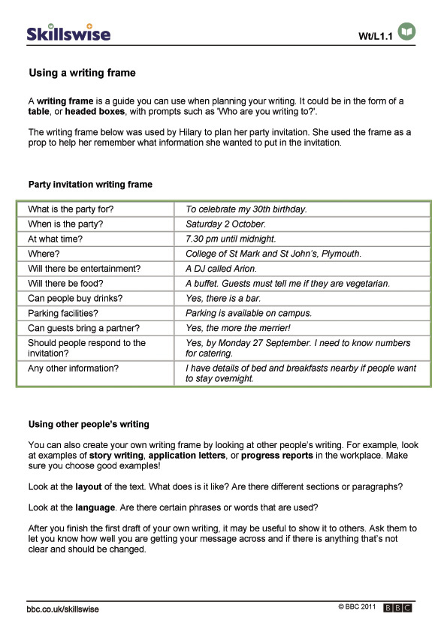
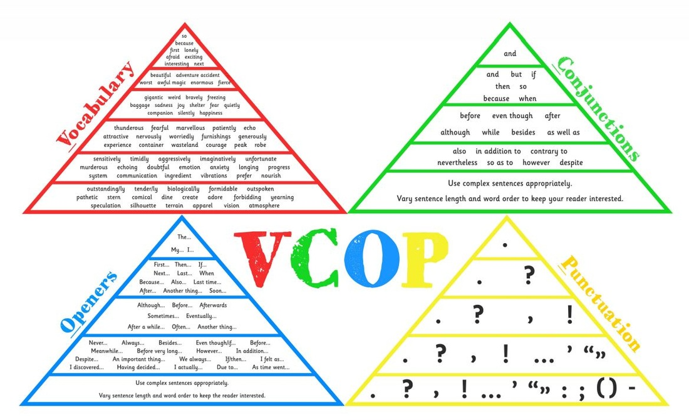
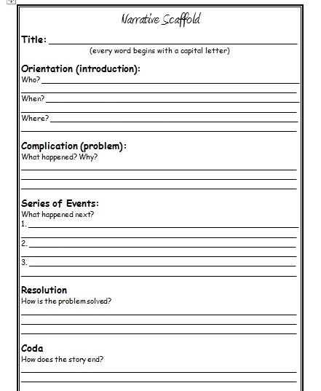
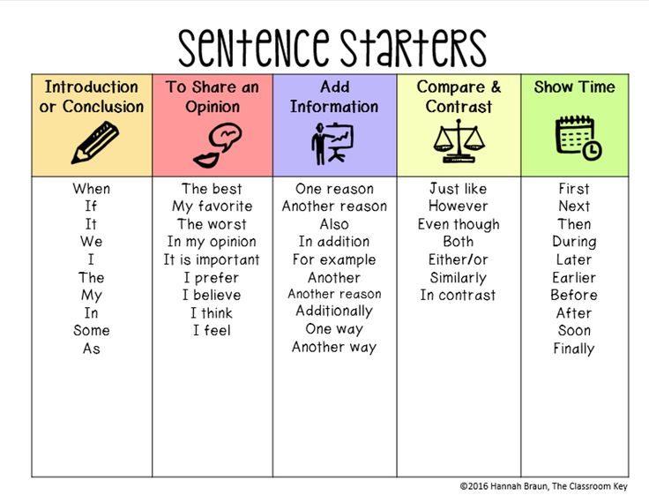
English equivalent
Discuss the motivations of the Capulet family in Romeo and Juliet.
……………………………………………………………………………………………………
……………………………………………………………………………………………………
……………………………………………………………………………………………………
……………………………………………………………………………………………………
……………………………………………………………………………………………………
……………………………………………………………………………………………………
……………………………………………………………………………………………………

Slide 8
Parsons Problems
“Parsons problems are problems where students build programs from ordering small chunks of provided code.”
http://csteachingtips.org/tip/use-parsons-problems-quizzes-and-tests-assess-student-understanding-code

Slide 9
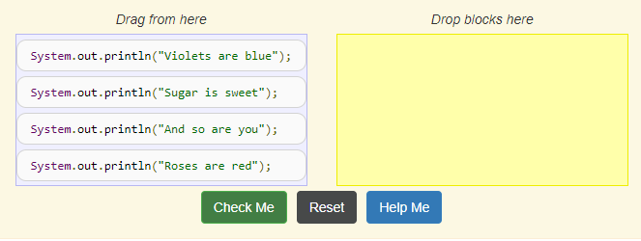
Example
https://runestone.academy/runestone/static/JavaReview/Strings/StringPracticeParsons.html

Slide 10
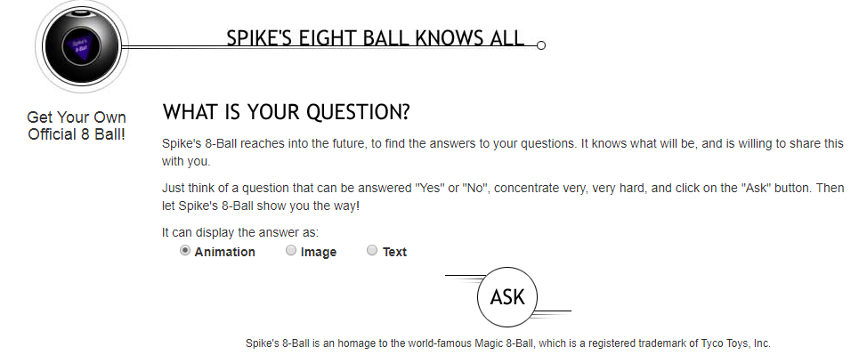
KS3 Example - Magic 8 Ball

Slide 11
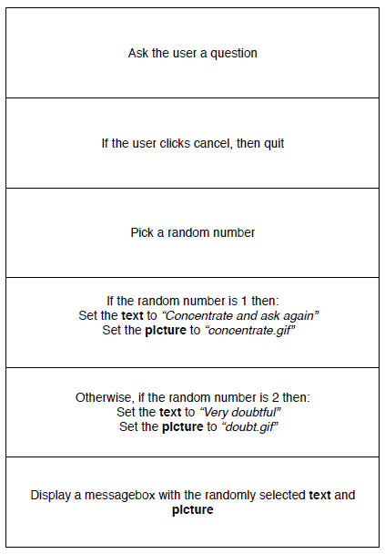
KS3 Example - Magic 8 Ball

Slide 12
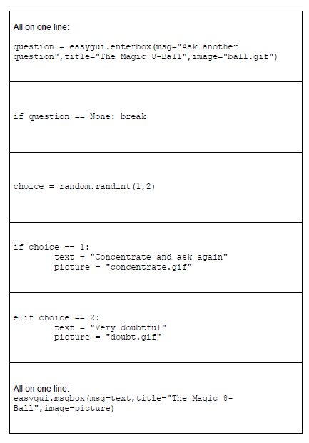
KS3 Example - Magic 8 Ball

Slide 13
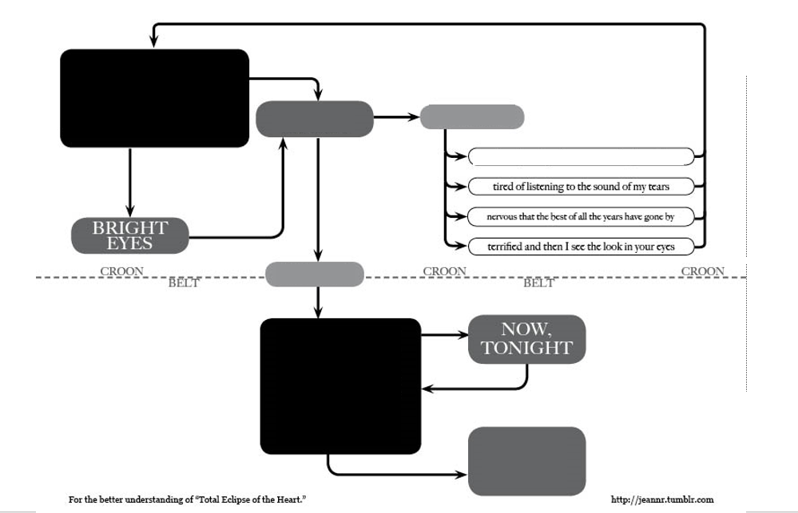

Slide 14
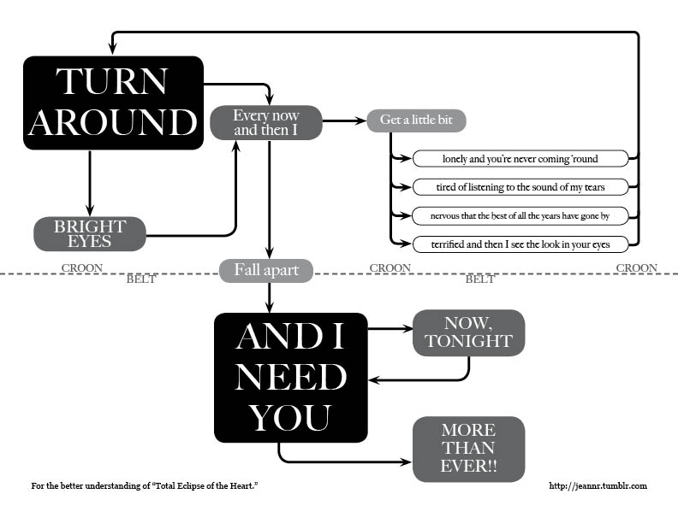

Slide 15
Ideas:
Flowcharts – Cup of Tea (peach slips)
Natural English → Scratch (blue slips)
Scratch → Python (purple slips)
Fill in the gaps – While Loops (white booklet)

Slide 16
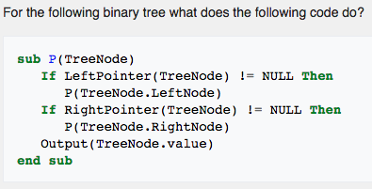
Additional Examples
GCSE exam prep
Bubble sort (Python and Java versions)
Tree Traversal Algorithms

Slide 17
Clarkson’s Golden Rules for Teaching programming
Never set a task you haven’t programmed yourself
Program your own solution, then remove code to provide a scaffold
Every student needs their own level of help and support, but talented programmers will not be stunted by it!

